Slide 1
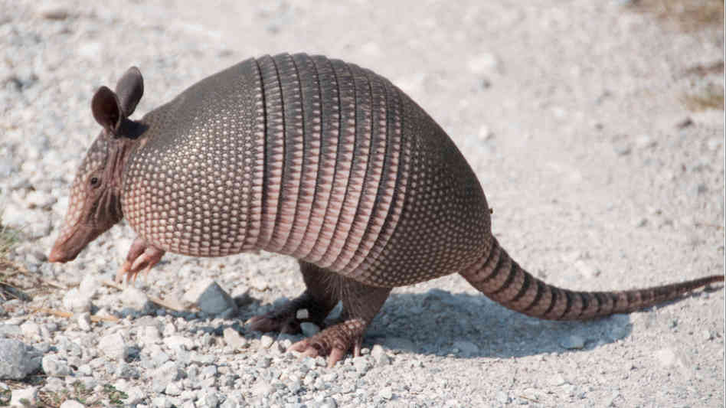


Slide 2
Project overview
QT 5.6
mbed TLS v2.2.1
Server role
Registers and verifies clients
Supplies clients with time limited certificates (x.509)
SuServer-Client - TLS
Client role
All communication between clients is organized without server
Diffie-Helman protocol establishes limited-time key
Messages encrypted and authenticated by AES-256 and HMAC-SHA512

Slide 3
Server-client communication
24hr valid client-side certificates
Communication established through TLS
Lifeline of communication
Server verifies login information of client
Client creates RSA pair and sends public key to server
Server signs public key and sends back signed public key

Slide 4
Client-client communication
Rotating keys secured by SessionKey class
Thread-safe
Key use limit
AES in gcm mode for both authentication and protection
Sender || receiver || timestamp || [DH] ||(k-id || E(k, payload))
Weakness: Message replay (add msg counter for key?)

Slide 5
Client-client example
Alice
Bob
certificate
certificate
verification
Initial Diffie-Helman
Result: key1
key1
01Message[key1][DH]
02Message[key1]
10Message[key1]
key2
[DH2]
key2
11Message[key2][DH]

Slide 6
File transfer
Sender sends file length and his transferID to receiver
Reciever sends received transferID back with his TransferID
Sender sends chunks with transfer ID and position in file
Reciever receives chunks and put them in file
Weakness: no checking if file transfer is complete

Slide 7
Certificates
X.509
After login client generates RSA key pair and sends certificate request to server
Server signs certificate and sends it back to client
In beginning of clients communication they exchange and verify each other certificates

